Slide 1









ATAI
Advanced Technique of Artificial Intelligence
ATAI
ChongqingUniversity _{AdvancedTechniqueof}
of Technology Artificial Intelligence
Chongqing University of Technology
Chongqing University ^{ATAI}
_{of Technology} Advanced Techniqueof
Artificial Intelligence
Chongqing University of Technology
Chongqing University of Technology
Frequency Spectrum is More Effective for Multimodal Representation and Fusion: A Multimodal Spectrum Rumor Detector
Code:https://github.com/dm4m/FSRU
—— AAAI ’24
Reported by Shu Ming Jiang
1

Slide 2
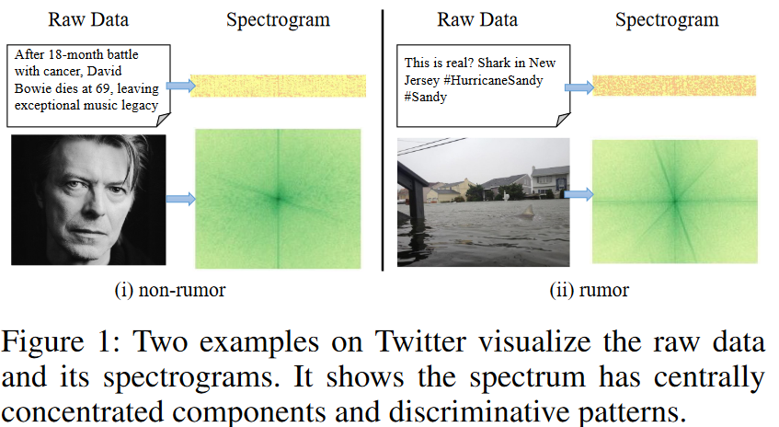
ATAI
Advanced Technique of
Artificial Intelligence
ATAI
ChongqingUniversity _{AdvancedTechniqueof}
of Technology Artificial Intelligence
Chongqing University of Technology
Introduction
(1)To obtain informative uni-modal representation, researchers have employed various neural models, such as Convolutional Neural Networks (CNNs), Recurrent Neural Networks (RNNs), and Transformers to perform token mixing over spatial locations of images or sequential positions of text. However, these methods suffer from less discriminative unimodal representation, hindering subsequent fine-grained cross-modal fusion.
(2)Existing approaches often apply contrastive learning or co-attention mechanisms to achieve multimodal alignment or fusion for detecting rumor across modalities. However, they may either overlook the interpretable fine-grained fusion or encounter intricate location dependencies in fusing spatial and sequential tokens. Moreover, current approaches for fine-grained fusion, such as co-attention mechanisms, often exhibit quadratic time complexity

Slide 3
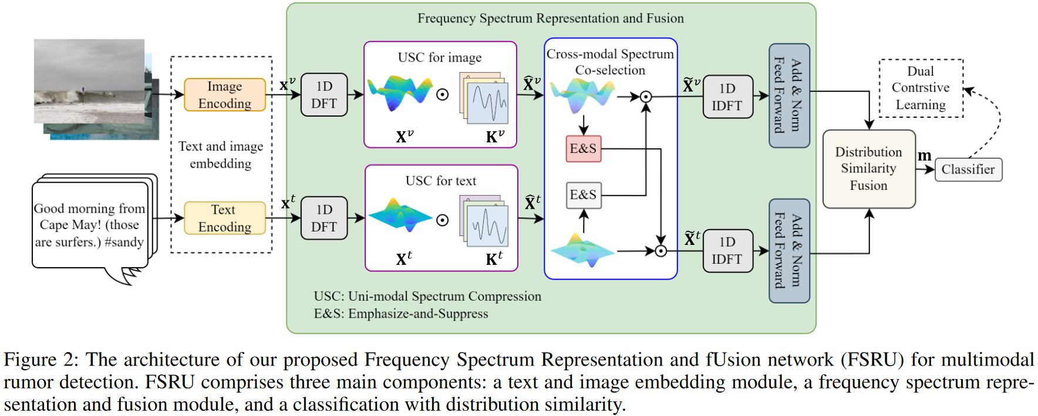
ATAI
Advanced Technique of
Artificial Intelligence
ATAI
ChongqingUniversity _{AdvancedTechniqueof}
of Technology Artificial Intelligence
Chongqing University of Technology
Overview

Slide 4
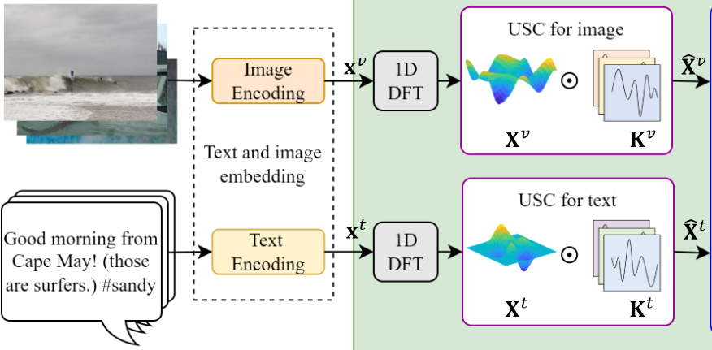
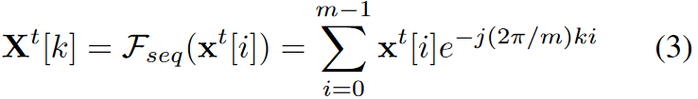
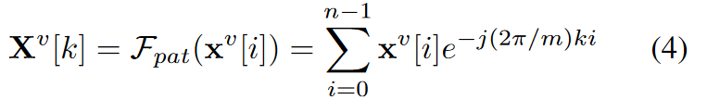
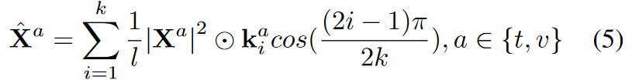
ATAI
Advanced Technique of
Artificial Intelligence
ATAI
ChongqingUniversity _{AdvancedTechniqueof}
of Technology Artificial Intelligence
Chongqing University of Technology
Method

Slide 5
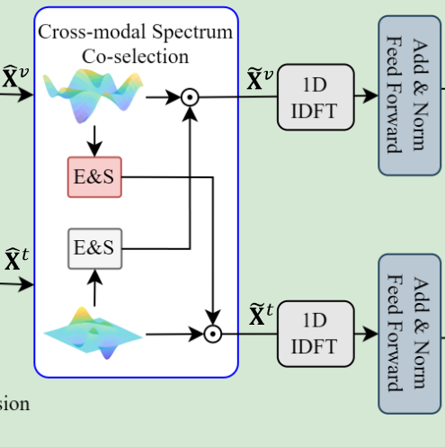
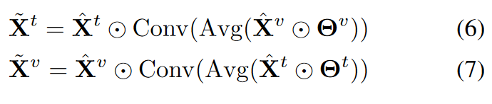
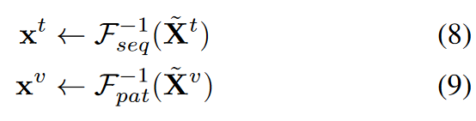
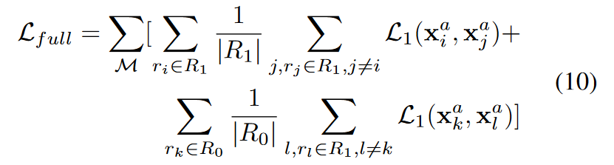
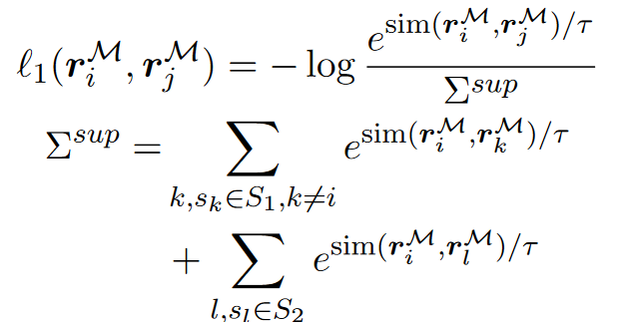
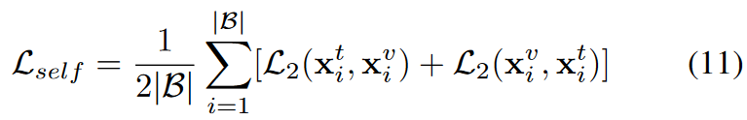
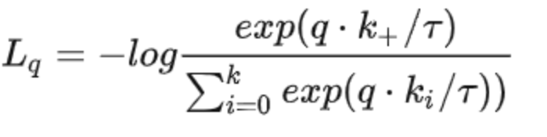
ATAI
Advanced Technique of
Artificial Intelligence
ATAI
ChongqingUniversity _{AdvancedTechniqueof}
of Technology Artificial Intelligence
Chongqing University of Technology
Method

Slide 6
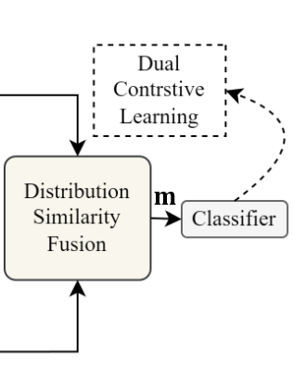

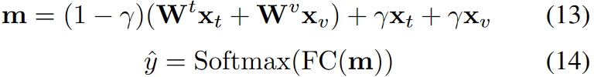
ATAI
Advanced Technique of
Artificial Intelligence
ATAI
ChongqingUniversity _{AdvancedTechniqueof}
of Technology Artificial Intelligence
Chongqing University of Technology
Method

Slide 7
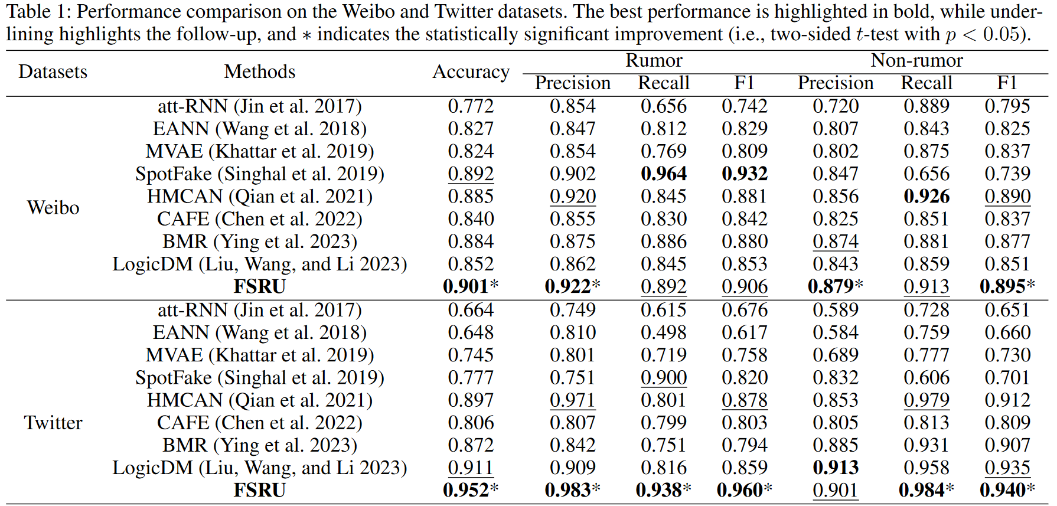
ATAI
Advanced Technique of
Artificial Intelligence
ATAI
ChongqingUniversity _{AdvancedTechniqueof}
of Technology Artificial Intelligence
Chongqing University of Technology
Experiments

Slide 8
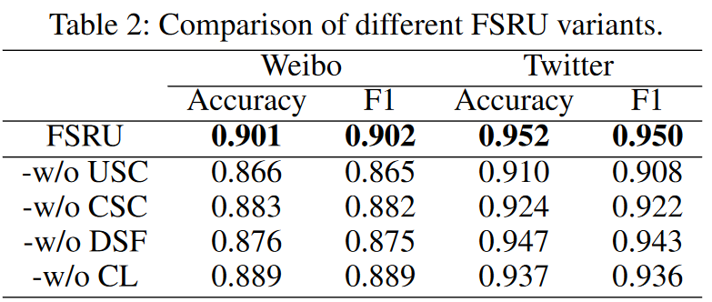
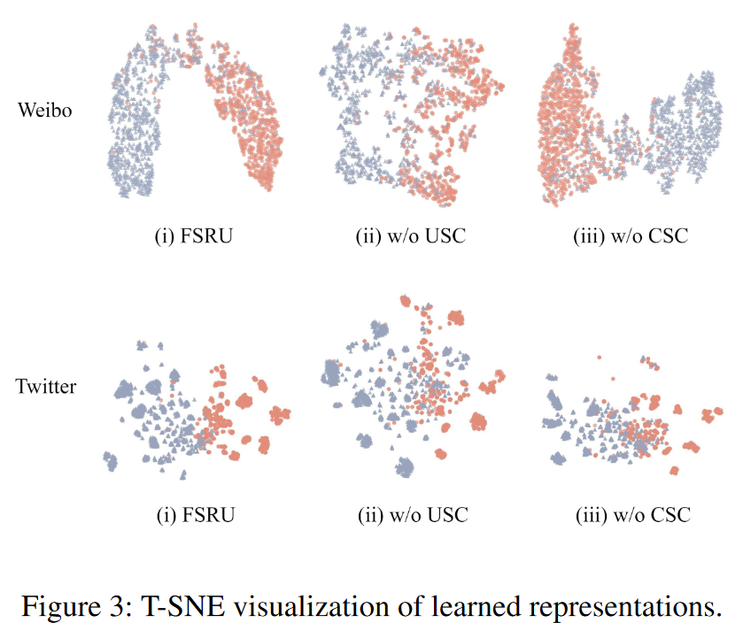
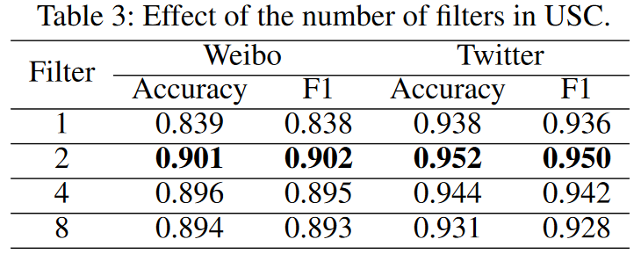
ATAI
Advanced Technique of
Artificial Intelligence
ATAI
ChongqingUniversity _{AdvancedTechniqueof}
of Technology Artificial Intelligence
Chongqing University of Technology
Experiments

Slide 9
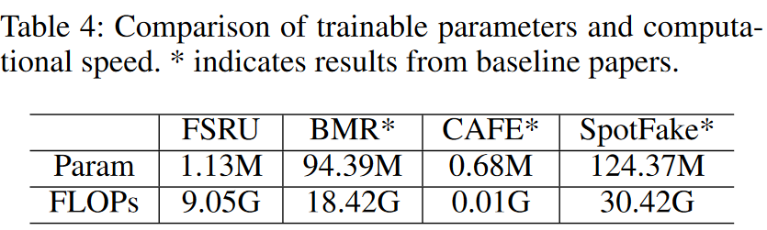
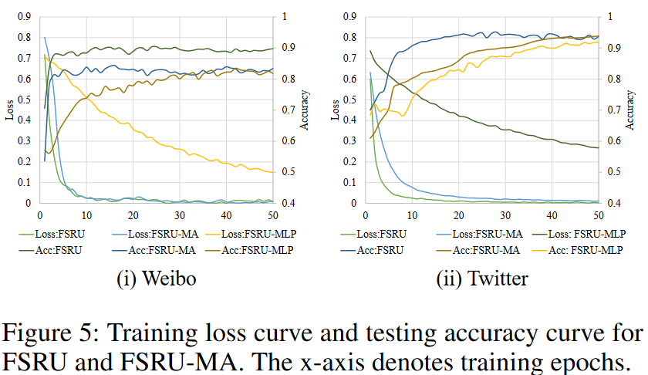
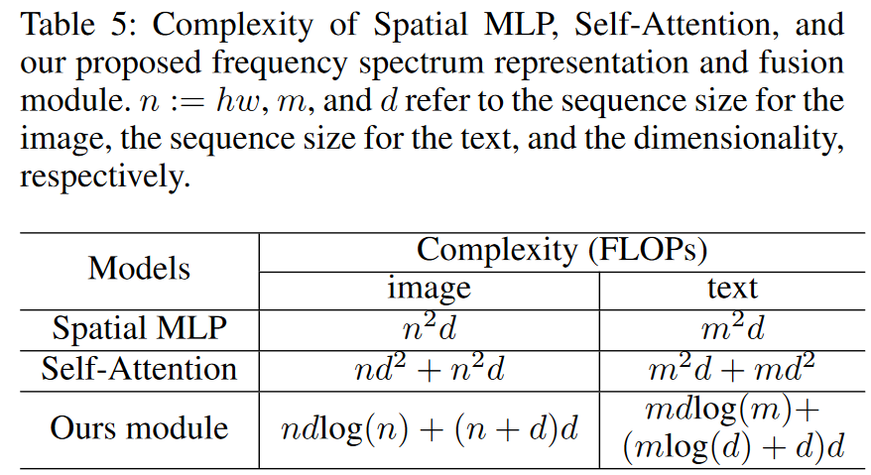
ATAI
Advanced Technique of
Artificial Intelligence
ATAI
ChongqingUniversity _{AdvancedTechniqueof}
of Technology Artificial Intelligence
Chongqing University of Technology
Experiments

Slide 10
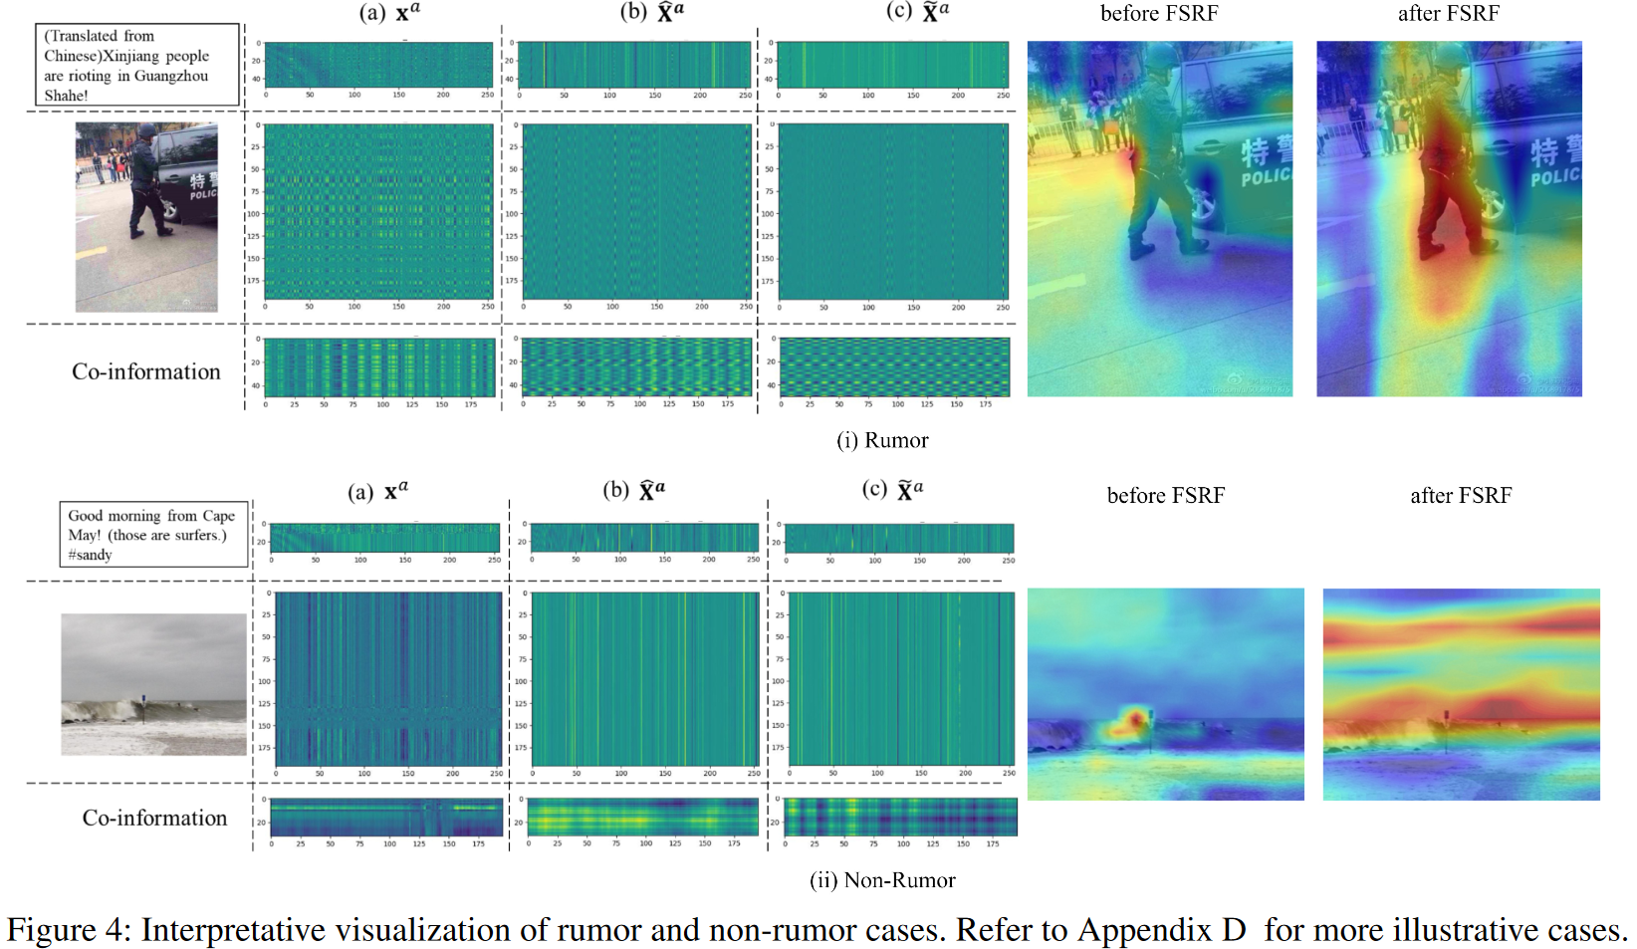
ATAI
Advanced Technique of
Artificial Intelligence
ATAI
ChongqingUniversity _{AdvancedTechniqueof}
of Technology Artificial Intelligence
Chongqing University of Technology
Experiments

Slide 11
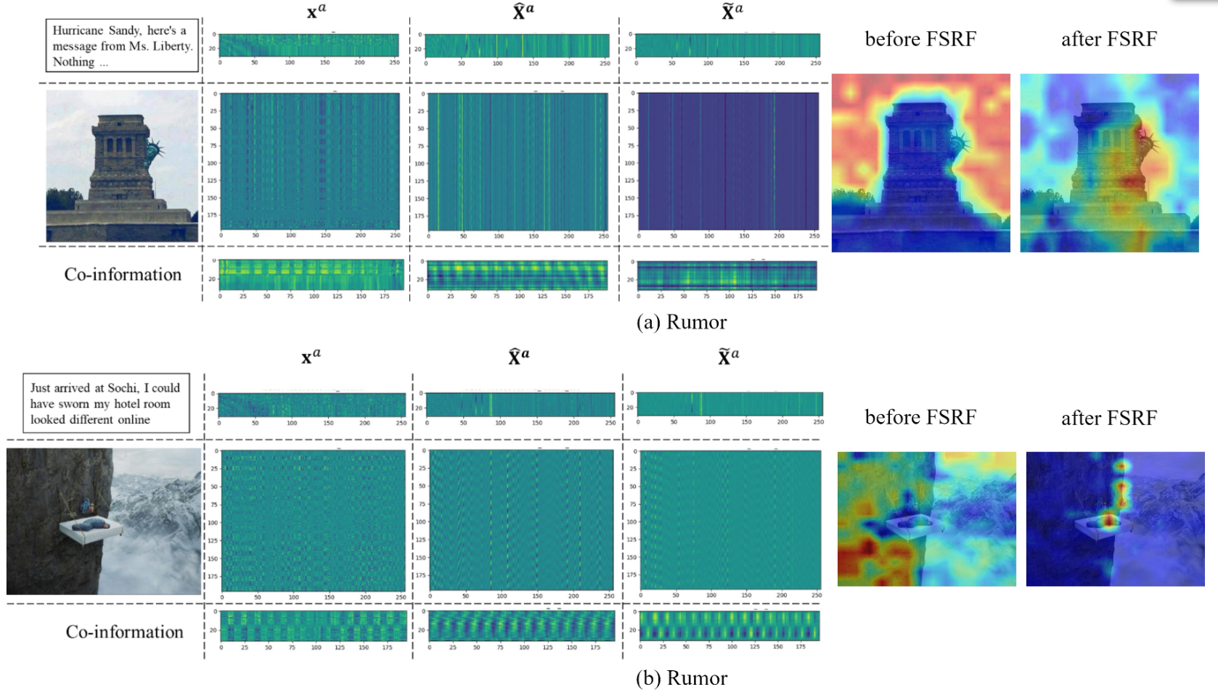
ATAI
Advanced Technique of
Artificial Intelligence
ATAI
ChongqingUniversity _{AdvancedTechniqueof}
of Technology Artificial Intelligence
Chongqing University of Technology
Experiments

Slide 12
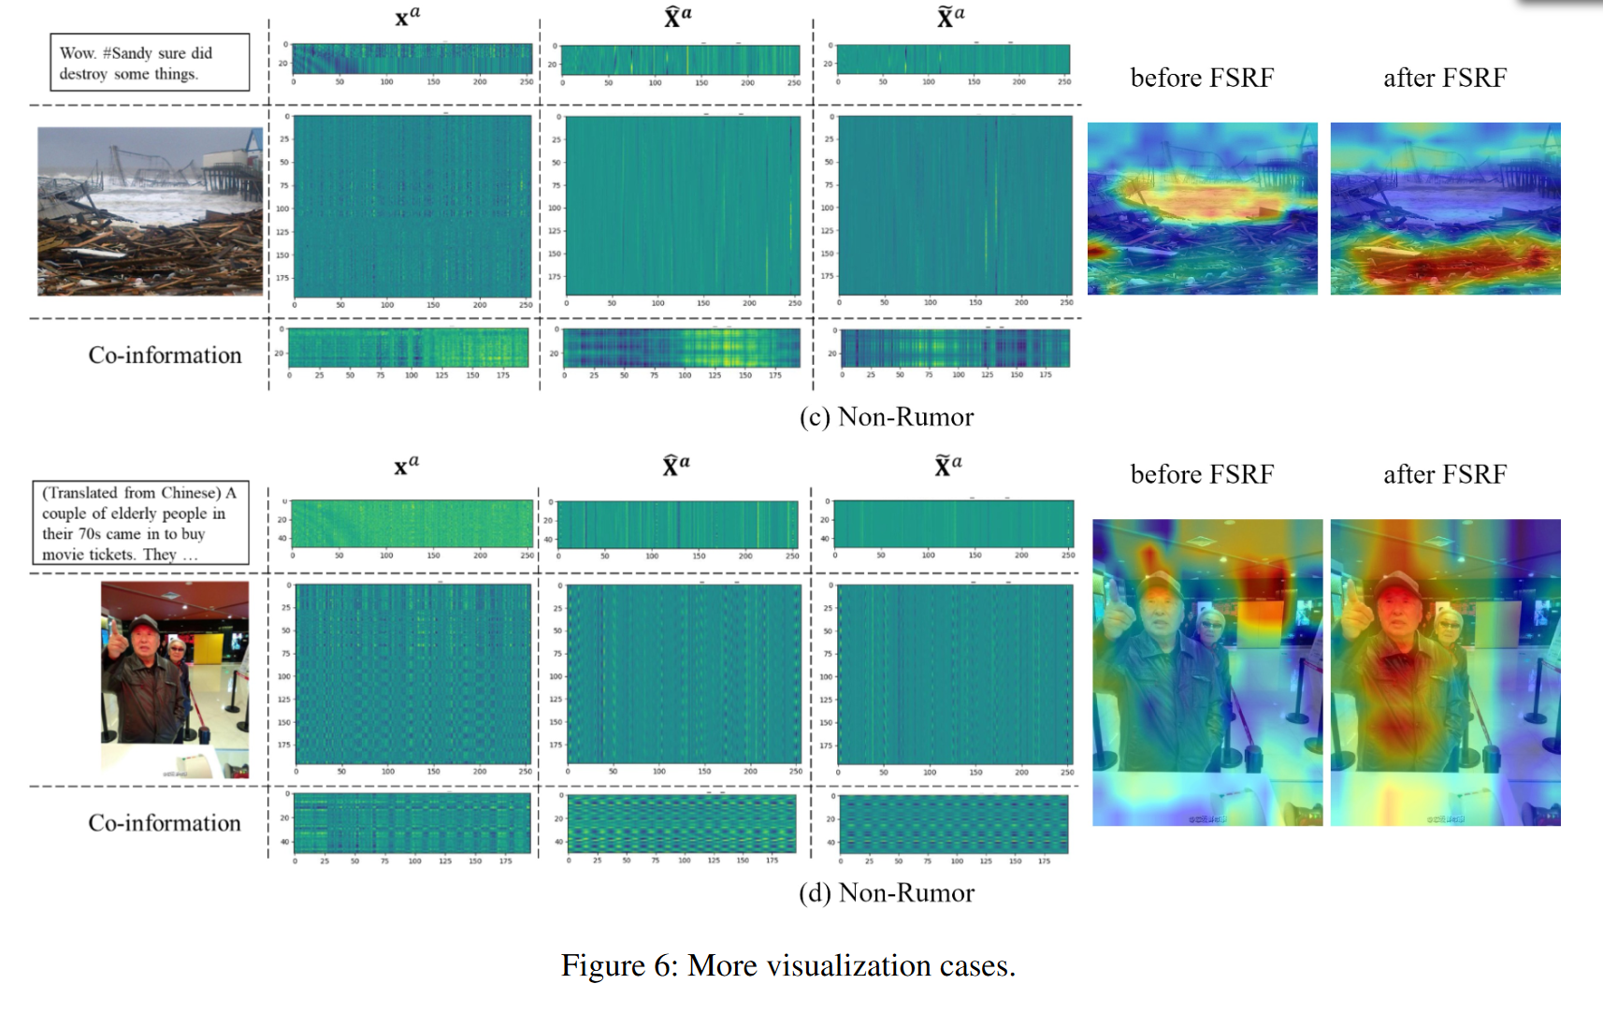
ATAI
Advanced Technique of
Artificial Intelligence
ATAI
ChongqingUniversity _{AdvancedTechniqueof}
of Technology Artificial Intelligence
Chongqing University of Technology
Experiments

Slide 13


ChongqingUniversity of Technology
ATAI
Advanced Technique of
Artificial Intelligence
ATAI
ChongqingUniversity _{AdvancedTechniqueof}
of Technology Artificial Intelligence
Chongqing University of Technology
Thanks!

